Slide 1



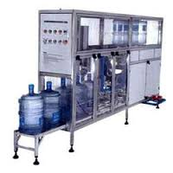
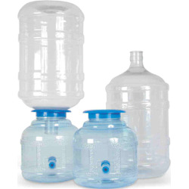



Port-Flex Drinking Water Business Concept
(An Indo-Dutch Co-operation)
Typical Scope of Port-Flex
(Stand-alone 24x7 Drinking Water Supply as per WHO Standard)
Jar Blowing Plant
Quality Monitoring
Water Testing
Bore well or Surface water
Portable Silent
DG Set
Option 1 (Selling in 20 lit.jars)
Portable Water Storage tank
Water
Filling
Station
Portable WTP
Water Intake System
Portable Panel cum Operator’s room
Option 2
(Direct Pumping into household)
Buffer Tank (Optional, if reqd.)
Branding, marketing and distribution
Solar
Grid
DG
Input Power & PLC
For Details & Offer please contact
J.K.Gupta
Mob: +91 98102 66875
Mail ID jkgupta@excellenceengineering.net
Client’s Scope

